Slide 1
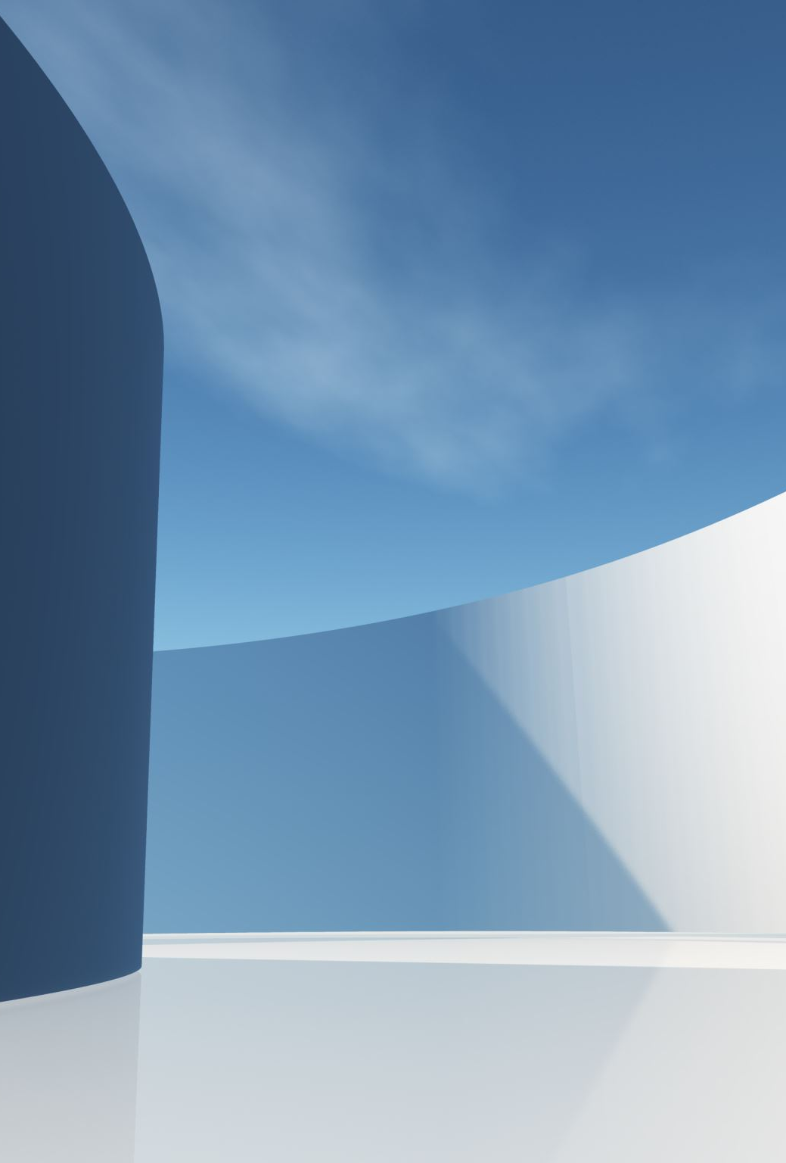
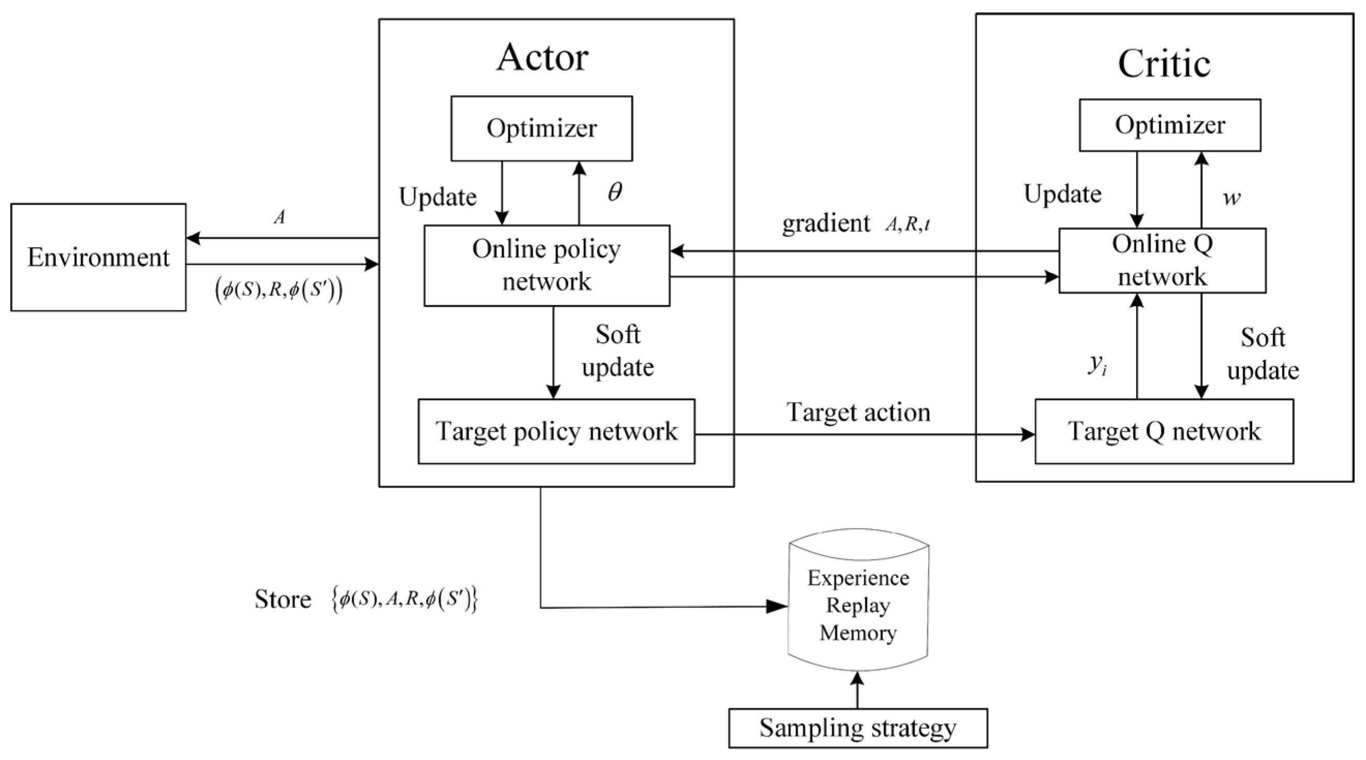
Multı-Robot Collabratıon

Slide 2
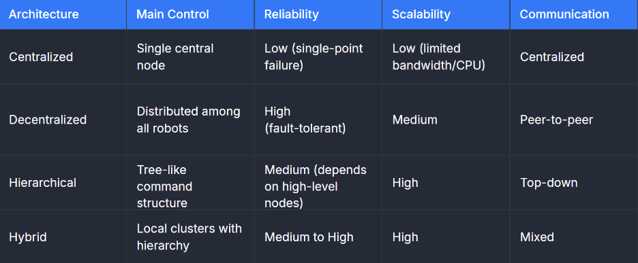
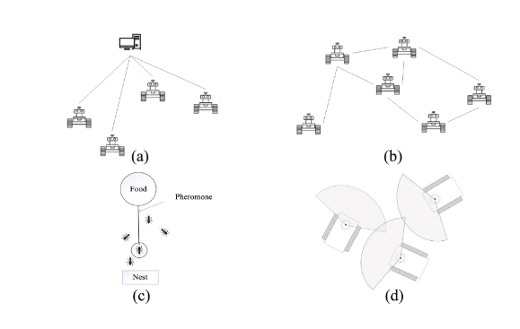

Slide 3
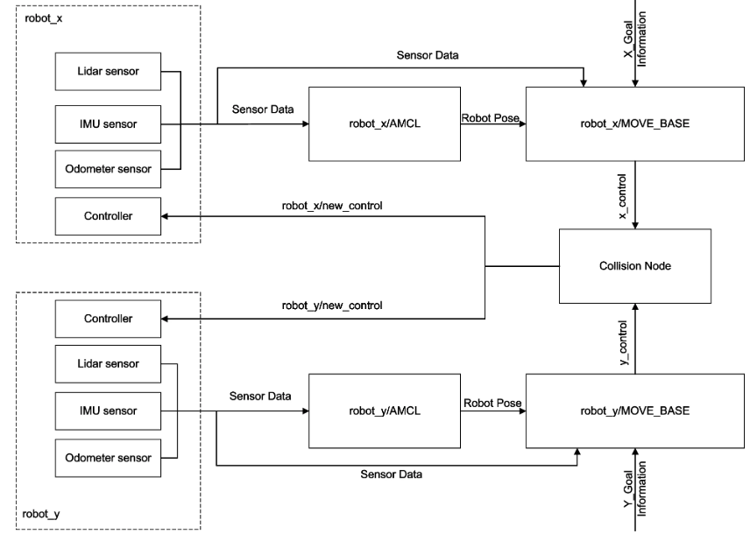

Slide 4
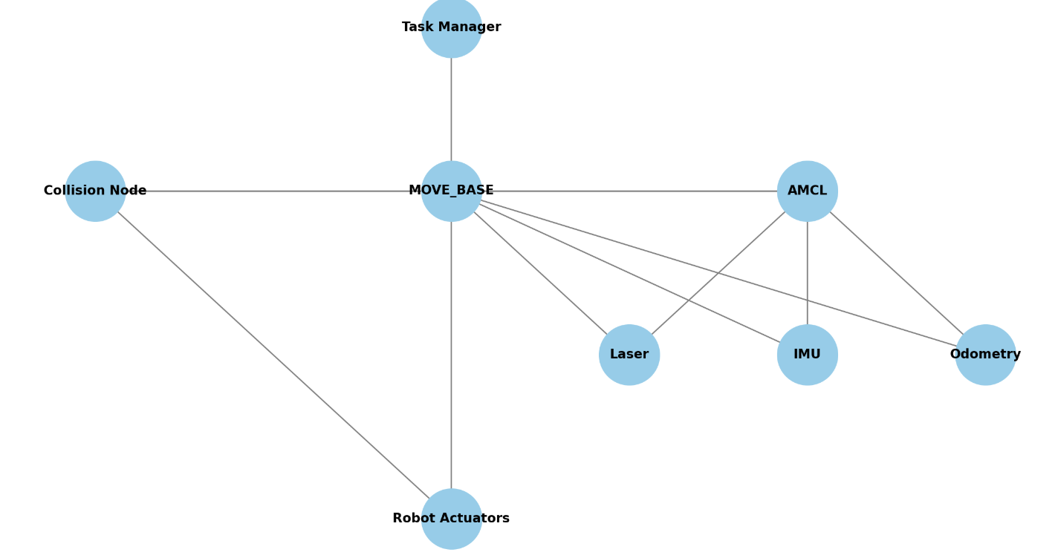
Task Manager
It decides the target location (goal point) for each robot.
MOVE_BASE
This is the main navigation node
It plans the best path to the goal
AMCL (Augmented Monte Carlo Localization)
It estimates where the robot is on the map
It uses sensor data: Laser, IMU, Odometry
Collision Node
Checks if two robots might crash into each other
If a collision is possible it sends a new control command to avoid it
Robot Actuators
These are the robot’s motors
They move to robot based on commands from move_base and collision node

Slide 5
